Slide 1
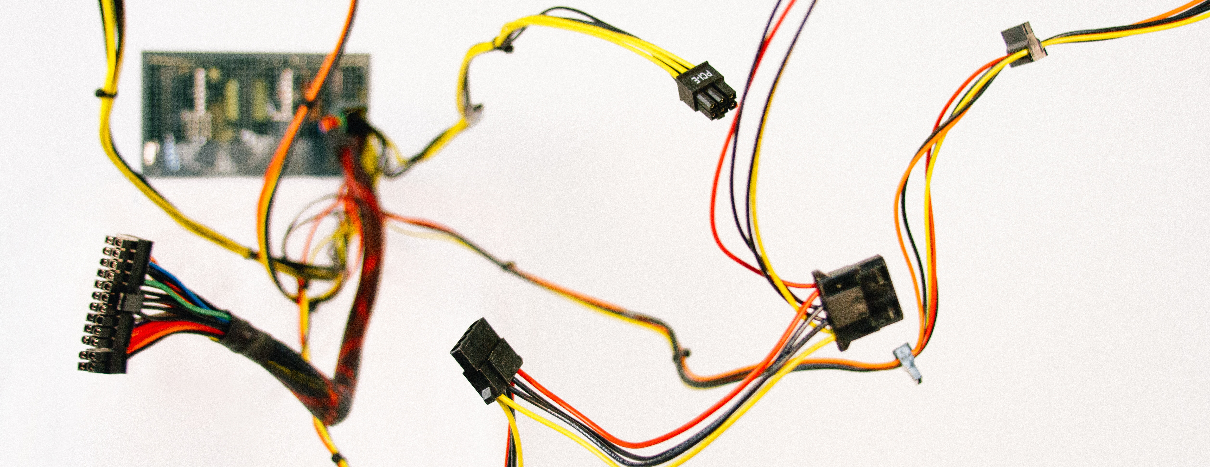
Predictive Maintenance of Customer Premises Equipment using Maching Learning Techniques
Master Thesis EPFL – Hugo Moreau 2018
Presentation for Pr. Robert West and Pratheep Ravy
7th of September 2018
Notes:
In the next 30 minutes I would like to talk to you about the master Thesis I conducted in the Data Management team at UPC Cablecom.
The project aimed at building a proof of concept around Customer Premises Equipment (what I will now refer to as CPE) Failure prediction.
At the end of the presentation we will have some time for questions. This presentation was designed to be understood as a whole and therefore unless you judge it necessary I would really appreciate if you could save your questions for the end.

Slide 2
Current State
HFC Architecture
Identified Problem
Data Sources
Dataset Construction
Failing CPE Identification
Health Measurements
Offline CPE Handling
Implementation
Data Analysis
Exploratory Analysis
Data Preprocessing
Label Propagation
Prediction
Cross-Validation
Performance Metrics
Model Exploration
Discussion
Model Output and Behaviour
Improvements
Notes:
Let’s look at the different point that I will present today.
[CLICK] I should start by giving an overview of the status quo by giving some information regarding UPC’s business, the problem we identified and the different sources of data that are envisioned to solve such problem
[CLICK] In a second time I should describe how we constructed the dataset in order to challenge this status quo. From the identification of Failing CPEs, the choice of health measurements to track, how we handled Offline CPEs, to finally explain implementation methodology.
[CLICK] Thirdly we should cover Data analysis to justify our preprocessing steps and we will describe our tentative a label propagation.
[CLICK] The predictive approach will follow. There we should discuss how we evaluated the performance of our model and the results of our model exploration.
[CLICK] Finally we shall discuss the results of the model and how the information yielded by this POC to move forward to a production software.

Slide 3
Current State
HFC Architecture
Identified Problem
Data Sources
Dataset Construction
Failing CPE Identification
Health Measurements
Offline CPE Handling
Implementation
Data Analysis
Exploratory Analysis
Data Preprocessing
Label Propagation
Prediction
Cross-Validation
Performance Metrics
Model Exploration
Discussion
Model Output and Behaviour
Improvements
Notes:
Before we can start explaining the project we would like to set the framework of such problems.

Slide 4
Current State
HFC Architecture
Fiber
Coax
Splitter
Tap
Headend
(connection to the rest of the network)
Hub
(Responsible for a region)
CMTS
(Physical device that splits Bandwidth into different frequency ranges)
Node
O/E – optical to electrical
Amplifier
CPE
Customer Premises Equipment
…
Notes:
Project tightly linked to UPC network architecture => overview
UPC uses Hybrid Fiber Coaxial architecture.
[CLICK] we focus on only two active nodes CMTS and CPE
The CPE is the device for which we try to predict: set top box, or simple internet router
CMTS splits bandwidth into frequency range
[CLICK] For this node we should look more closely into the inner workings
--------------------------------------------------------------------------------------------------------------
As this project is tightly connected to the architecture of the network I will give the necessary information to understand the decisions that have been undertaken.
UPC uses a hybrid fiber coaxial architecture. It is composed of many components but hopefully we should focus on the two active nodes of the network: [CLICK] CMTS and CPE.
The CPE is the device for which we are aiming to predict potential failures, it can be a simple router or a set top box that provides digital television, telephone and internet.
The CMTS on the other hand splits the available bandwidth into different frequency ranges. [CLICK] The details of its inner workings are important.

Slide 5
Current State
HFC Architecture
CPE
1-20Hz
Service Group
Connection Interfaces
CPE to Connection Interfaces
Frequent changes (~Hours)
e.g. 300 Hz
CPE to Service Groups
Stable (~Days)
Notes:
The CMTS splits a given bandwidth, for example 300Hz, into service groups which are frequency ranges.
Each service group has multiple connection interfaces
What we want to point out is that: [CLICK] mapping between connection interface and CPE is unstable
While [CLICK] the one between the service group and the CPE is much less likely to change
---------------------------------------------------------------------------------------------------------------------
Each service group has multiple connection interfaces. [CLICK] The mapping between a specific CPE and such interface changes dynamically (by order of hours) depending on many parameters such as load. On the other hand the mapping between a service group and a CPE [CLICK] is much more stable as it can change only every few days and changes are rare.
This information will be used later on when we try to link data polled at the CMTS level and at the CPE level.

Slide 6
Current State
Identified Problem
We own the network and can challenge the status quo
Regular polling of the network, collected from different sources in various forms
Customer behavior problems:
Identify problems that carry more or less importance
Machine Learning can help us shifting from passive troubleshooting to proactive
Notes:
The current situation at UPC offers some opportunity:
Go through the 4 steps
Machine learning techniques could help the company increase the knowledge of such issues, to understand customer behavior but also to shift from a passive to an active troubleshooting.

Slide 7
Current State
Data Sources
SAA
VIA
CMTS interfaces & CPEs
Regular polls of metrics
10 days of history
Customer interaction with help desk
Human input
Can be leveraged to characterize the ‘health’ of the CPE
Indicator of customers that are experiencing issues with their CPEs: flag failing CPEs
How can we transform and interpret this data such that it gives us a meaningful dataset to build a predicting classifier?
Notes:
With the identified problem in mind we can see which data sources we plan to use
[CLICK] SAA
[CLICK] VIA
[CLICK] Now we need to figure how this data can be interpreted and transformed to build a prediction model.
-------------------------------------------------------------------------------------------------------------------------------------------------
Now that we have identified a problem we also need to identify the different sources of data that could be leveraged in order to solve such problem.
On one hand we have Serv-Assure or SAA for short [CLICK]. For troubleshooting purposes, each CPE and CMTS connection interfaces are polled every 15 minutes for many metrics. The polled values are stored for 10 full days. The metrics that are polled could be used in order to characterize the health of a CPE.
On the other hand, VIA (Virtual Interactive Assistant) [CLICK] contains information regarding interactions between the customer and the help desk. Entries in this database are to be handled carefully as they are entered by human agents. If we transform it correctly we could use this data to detect customers that are experiencing issues and therefore flag some failing CPEs.
[CLICK] We should now explain how this data can be transformed and interpret to built a prediction model.

Slide 8
Current State
HFC Architecture
Identified Problem
Data Sources
Dataset Construction
Failing CPE Identification
Health Measurements
Offline CPE Handling
Implementation
Data Analysis
Exploratory Analysis
Data Preprocessing
Label Propagation
Prediction
Cross-Validation
Performance Metrics
Model Exploration
Discussion
Model Output and Behaviour
Improvements
Notes:
The most time consuming and challenging step of this project resided in the construction of the dataset. Indeed a machine learning algorithm is only as good as the data that it is fed. We shall now explore the methodology that was employed in order to perform such task.

Slide 9
Dataset Construction
Failing CPE identification: Vocabulary
A session for each call
The agent follows flows. And might try many in parallel to find most appropriate
Each flow emits milestones that gives labels to each step of the process.
Only one flow will yield the resolution of customer problems
Notes:
First we should explore how we leveraged the data from VIA.
Before VIA: need to understand how entries are stored and give some vocabulary.
Each customer’s call corresponds to a session.
[CLICK] During session, multiple flow = diagnose and solve issue, don't know which will solve to many concurrent ones
[CLICK] A flow consists of multiple steps: whenever a step is achieved, milestone emitted and logged in. Gives human readable labels to each step, each event is indexed depending on creation time.
[CLICK] Finally only one of the flow will yield the end of the call and it is the one that should have solved the problem
---------------------------------------------------------------------------------------------------
[CLICK] During this session, the technical help desk agent follows flows which are processes guiding him in order to diagnose and solve the issue. Because he or she may not know which particular flow will solve the problem, the agent often starts many concurrent flows.
[CLICK] Flows consist of different steps and after each step completed a milestone is emitted and logged in by the software used by the agent. These milestones give human readable names to each step and they are given event ids increasing depending on the creation time of the milestone.

Slide 10
Dataset Construction
Failing CPE Identification: VIA as a tool to flag failing CPEs
Focus only on the full flows: those that ended the call and most likely yielded customer satisfaction
Label the failure: thanks to starting milestones of the flow (e.g internet.noconnection.start, internet.interruption.start, ..)
Confirm labeling: using the First time resolution flag from Clarify
Map Clarify to VIA: fuzzy matching and assume that on the same day one account number can only be serviced by the same employee once
Map to devices: MAC of device concerned by a session isn’t stored. We assume all customer’s CPEs are failing in case of call
Focus on internet problems: to limit the scope of our analysis and consider the most appropriate type of problem
Notes:
Here are the different steps that allowed us to leverage VIA:
Focus on full flows: the one that solved the problem
Then find the label of the issue using the first milestone of this flow
Can happen not FTR, therefore we confirm our labeling by inspecting the flag from CLY.
To use this flag we had to perform a fuzzy matching as well as some assumptions in order to obtain a one to one mapping.
So far we know a particular customer has problem but had o way to know which CPE was experiencing pbs: assume all of them are.
Finally to reduce scope we focused on internet pbs: also the ones that yield the most probable correlation with Health Measurements.
-------------------------------------------------------------------------------------------------------------
In order to use this source of data we had to derive a strategy.
We had to focus only on full flows, that is the flow that yielded the end of the call and most probably the resolution of the customer problem.
At first we wanted not only to identify a failure but also to be able to name such failure. To do so, we used the first milestone of the full flow in order to obtain a human readable name of the issue.
It may happen that a call ended and that the problem wasn’t solved as the customer had to call again. Therefore, we used a flag computed in another data source called clarify. This flag is set after seven days when the call corresponded to a First Time Resolution.
In order to use this flag from clarify we had to match the interaction in this first data source with the session from VIA as there is no common id between the two. Nevertheless, every entry that is inserted in VIA is also automatically inserted in Clarify, therefore by making the assumption that an account number is unlikely to be serviced by the same employee on the same day we could reduce the output of the fuzzy matching into a one to one mapping.
Also, customer interactions do not contain the information regarding which mac was serviced but only the account number of the customer. Therefore, we had to make the assumption that all macs of the customer were experiencing issues when the customer calls.
Finally we restricted our analysis on internet problems to control the scope of this POC and consider only problems that would be likely to show in our health measurements.

Slide 11
Dataset Construction
SAA.CMTS_HOURS_UPSTREAM_STATS | Description
UTILIZATION | Maximum percent utilization of upstream
RXPOWER | Average power being received by CMTS on interface
TXPOWER | Average power transmitted from CMs on interface
CER | Maximum Codeword Error Ratio for interface
MS_UTILIZATION | Percent minislot utilization of upstream
Characterizing CPEs: SAA available values
SAA.CM_HOUR_HEALTH | Description
TXPOWER_UP | Average upstream transmission power
RXPOWER_UP | Average upstream reception power
RXPOWER_DN | Average downstream reception power
CER_DN | Maximum codeword error ratio downstream
CER_UP | Maximum codeword error ratio upstream
SNR_DN | Minimum signal-to-noise ratio downstream
PCT_TRAFFIC_SMDH_UP | Upstream severely degraded modem hours
PCT_TRAFFIC_MDH_UP | Downstream severely degraded modem hours
SAA.CMTS_HOURS_DOWNSTREAM_STATS | Description
UTILIZATION | Maximum percent utilization of downstream
RXPOWER | Average power being sent by CMTS on interface
CCER | Maximum Corrected Codeword Error Ratio for interface
CER | Maximum Codeword Error Ratio for interface
ACG_SNR | Average carrier to noise ratio for interface
Notes:
Then we had to chose the correct measurements in order to monitor the health of CPEs.
With the help of an expert from the Network support team, we derived 8 measurements taken at the CPE level
And 10 at the CMTS connection interfaces level.
These measurements are available on an hourly basis for 10 days.

Slide 12
Dataset Construction
Characterizing CPEs: Static information, Constructed Features and precautions
Static Features | Description
DAY_0 | Day at which we collect the measurements
MAC | Unique identifier of the CPE
CLY_ACCOUNT_NUMBER | Customer ID in Clarify
SAA_ACCOUNT_NUMBER | Customer ID in Serv - Assure
HARDWARE_MODEL | To help us compare comparable devices
Constructed Features | Description
OFFLINE | Might be a good indicator of failure
MISS_* | To keep the information of missing measurement
N_CPE_BUILDING | CPEs in a building share the same carrier and therefore we need to take in consideration the load on carrier.
Linking CMTS interfaces and CPE
Group Specificities
Average CMTS interface measurements at the service group level and linking service group with CPEs
Getting rid of the specificities of each Service group: standardizing at the service group level
Notes:
We also added static features: not time evolving over Day 0. We will see later on that all measurements will be considered relative to this day 0
Note that we have the hardware model as well as it may influence the values of health measurements.
[CLICK] Also we have constructed other features. (Go through them)
But also we had to overcome two challenges:
[CLICK] (Explain link CPE to CMTS interfaces) Hard to link interface to CPE. With HFC support found out that logical grouping is per service group hence average cmts mes.
[CLICK] (explain group specificities)
--------------------------------------------------------------------------------------------------------
But also we needed to add what we call static feature, that is features that do not change over time.
Note that we have collected the type of CPE that we are considering as according to the expert it may influence the health indicators previously collected but also because it might be useful for further data analysis.
[CLICK] We have also constructed some features in order to embed more information for our classification.
Offline: the status of a CPE could be a strong indicator of a potential problem
MISS_*: we will see in the next slide that we have aggregated our hourly measurements and therefore adding a flag that is set when a particular measurement is missing prevent a loss of information when aggregating.
N_CPE: the number of CPE in the building carries some importance as it gives us information regarding load of the carrier through the number of devices that share the same carrier.
Then we had to overcome two challenges:
[CLICK] As explained earlier the match between CMTS interfaces and CPEs isn’t stable, therefore we had to derive a logical grouping of CPEs. The expert advised to group CPEs at the service group level, therefore we averaged the CMTS interfaces metrics at the service group level and used these average as CMTS measurements for each CPE.
[CLICK] But also, previous projects at UPC have shown that a particular service group may have health measurements that are abnormally high even in the absence of any problem, therefore we standardized CPE measurements by service group to obtain comparable values.

Slide 13
Dataset Construction
Characterizing CPEs: Including the time dimension
Evolution > absolute value
=> Display difference between time periods
Noise may cause signal flaps
=> Display aggregates of at least 6 hours
For each measurement ‘X’
Last 24 hours: aggregate measurements over 6h windows
6
Last 6 days: aggregate measurements daily
X_{0-5h}
X_{6-11h}
X_{12-17h}
X_{18-23h}
X_{day -6}
X_{day -1}
X_{day 0}
-
-
-
-
-
-
X_18H
X_12H
X_6H = X_{18-23h} - X_{12-17h}
X_5D
X
Notes:
Last challenge: include the time dimension. We want to pack into a vector the evolution of measurement before a failure on a given date.
We considered two advices from the HFC support team:
[CLICK] We should focus more on the evolution of measurement than absolute => take differences between subsequent measurements
[CLICK] Flaps in the signal might appear due to noise, in order to handle such case we should aggregate the measurements on at least 6 hour windows
[CLICK] Explain the fine grain and coarse grain
------------------------------------------------------------------------------------------------------------
The last feature representation challenge consisted in including the time dimension of these measurements. We would like to have for each CPE a vector of features that can be correlated with a failure at a given date. So we had to embed the evolution of measurements in such format.
We followed the advices of the network support team:
[CLICK] We should monitor the evolution of the metrics rather than there absolute values, therefore we will display measurements relative to the previous measurement as their differences.
[CLICK] But also noise might cause signal flaps and therefore we should aggregate measurements by time window of at least 6 hours.
Hence for each measurement we consider two time periods:
Short history: last 24 hours over which we aggregate results by 6 hour windows
Long history: last 6 days over which we aggregate daily
This tradeoff of granularity allowed us to have both the fine detail of what happened recently and the evolution over a large period of time.

Slide 14
Dataset Construction
Characterizing CPEs: putting it all together
Day -5
Day 0
Day 1
Day 8
Time
Legend
Old History: Average measurements over days
Recent History: Average measurements over 6 hours windows
Failure: Day at which we monitor the failure using VIA
FTR Flag set: we know whether the VIA interaction solved the problem and therefore if the milestones properly identified the problem
Notes:
To synthesize the history of data that we consider…

Slide 15
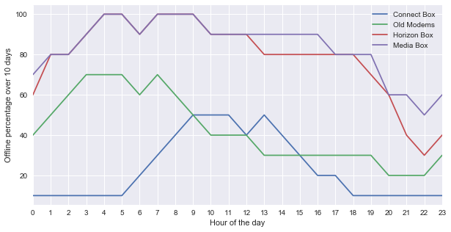
Dataset Construction
Offline CPE handling: From Outlier Detection to Deep Sleep Mode Exclusion
Offline CPE = no polled measurements
Rise in Energy saving concerns = Many switched off CPEs on low usage hours
Outlier Detection
For every hardware model
For each hour
Keep only the 99th Percentile (computed on offline time over all 10 days of SAA history)
Automatic Deep Sleep mode
Found that Horizon Box and Connect Box are offline most of the time
Regulation enforces that new CPE should have an automatic deep sleep mode when unused
Had to keep them out of our analysis
Notes:
Now we shall look into how we handle offline CPE indeed:
(Read the two reasons)
[CLICK] Explain how we tried to perform outliers detection
[CLICK] Show the curves and explain that we saw that Horizon and media boxes are offline most of the time. This gave us a hint that the HFC support team could help us with...
We have now seen the data that we wish to collect and how we would like to represent it. We will now look into the implementation.
--------------------------------------------------------------------------------------------------------
During our initial analysis we realized that offline CPEs wouldn’t have any polled values and could jeopardize our classification. Also intuitively we thought that with the rise in energy saving concerns, customers may be switching off their CPEs when they are not using it therefore we decide to get rid of CPEs that were abnormally offline.
[CLICK] In order to exclude such outliers, we looked for every hardware model over the last 10 days of history what is the offline percentage that would separate the population into 99%-1%. That means that every CPE with a value over this limit can be considered as an outlier.
But while we were looking at the result of such strategy we discovered some interesting result. [CLICK] This graph shows the offline percentage of each hardware model for every hour of the day. We saw that Horizon Boxes and Media Boxes are all offline most of the time. This allowed us to discover that those recent CPEs have an automatic deep sleep mode that is mandatory due to regulation and is enabled by default. This meant that we had to keep them out of our analysis.
This concludes the presentation of what data we wish to collect, and how we would like to represent them. Our final step is to present how we actually implemented data collection.

Slide 16
Dataset Construction
Only 10 days of history available in SAA
2 environments:
DMP: computational power
DMT: storage capabilities
Implementation: Challenges and tables
DMP
DMT
Static information
6h window averages
Daily averages
VECTORS
DAILY_AVG_DAY_0
5 Day history consolidated vectors
Sick MACs information
1 day
2 days
VECTOR_FIVE_DAYS
VIA_MACS
Difference between daily averages
Sick MACs information
DAILY_AVG_DIFFS
VIA_MACS
Store the full history of computations
5 days
1 day
Notes:
In order to construct our dataset we faced a couple of challenges.
[CLICK} first we only had 10 days of history in SAA but also two working environment, the production data mart that offered high computational power and the test one that proposed high storage capability.
[CLICK] Hence we split our work in two.
[CLICK] First we created 4 buffer tables on DMP to store the results of our aggregation.
[CLICK] Then we created 2 storage tables on DMT in order to dump DMP tables and avoid using more resources than necessary on the production environment.
All tables are filled following a rolling window mechanism updating their content daily.

Slide 17
Dataset Construction
Current day = 11/01
var_day_0 = 10/01
Implementation: Rolling window
DMP
DMT
Aggregate 6 hour window averages into daily averages
Compute the 6h window averages
BEFORE EXECUTION
09/01
10/01
10/01
09/01
08/01
VECTORS
DAILY_AVG_DAY_0
VECTOR_FIVE_DAYS
VIA_MACS
09/01
01/01
08/01
DAILY_AVG_DIFFS
07/01
VIA_MACS
06/01
05/01
Notes:
Before execution we suppose that the state of DMP has been initialized.
We are the 11th of Jannuary, therefore we consider day_0 to be the 10th to have the full saa history for this day.
[CLICK] Before execution, the tables contain the content for the previous day_0.
[CLICK] To update the content we compute the 6 averages for this new day_0
[CLICK] Then we aggregate the 6 hours averages into daily averages
[CLICK] We compute the difference between daily averages of day_0 and day_-1

Slide 18
Dataset Construction
Current day = 11/01
var_day_0 = 10/01
Implementation: Rolling window
DMP
DMT
Compute the difference between the daily averages
Aggregate 6 hours window averages into daily averages
09/01
10/01
10/01
10/01
10/01
09/01
09/01
VECTORS
DAILY_AVG_DAY_0
VECTOR_FIVE_DAYS
VIA_MACS
09/01
01/01
08/01
DAILY_AVG_DIFFS
07/01
VIA_MACS
06/01
05/01
Notes:
[CLICK] And we flag the failing CPEs from 8 days ago

Slide 19
Dataset Construction
Current day = 11/01
var_day_0 = 10/01
Implementation: Rolling window
DMP
DMT
Compute the difference between the daily averages
Flag failing MACs using VIA
09/01
10/01
10/01
10/01
10/01
09/01
09/01
VECTORS
DAILY_AVG_DAY_0
VECTOR_FIVE_DAYS
VIA_MACS
01/01
10/01
02/01
09/01
DAILY_AVG_DIFFS
08/01
VIA_MACS
07/01
06/01
Notes:
.
[CLICK] We can finally build the full five days history vector in DMT. First

Slide 20
Dataset Construction
Current day = 11/01
var_day_0 = 10/01
Implementation: Rolling window
DMP
DMT
Build full five days history vectors
Compute the difference between the daily averages
10/01
10/01
10/01
10/01
09/01
09/01
VECTORS
DAILY_AVG_DAY_0
10/01
VECTOR_FIVE_DAYS
VIA_MACS
10/01
10/01
02/01
02/01
09/01
09/01
08/01
DAILY_AVG_DIFFS
08/01
VIA_MACS
07/01
Get static info and compute difference between 6 hour averages
07/01
Construct a flat vector with 5 days of daily average differences and append it to previous
06/01
06/01
Dump the content of VIA_MACS
Notes:
[CLICK] First we get the static information from VECTORS and then compute the 6 hours window averages differences
[CLICK] Then we append the flat vector of daily average difference for each mac
[CLICK] Finally we can dump the content of VIA MACs into the homonym table on DMT.
And we are done with execution.
This entire procedure was implemented to run automatically every day. Autonomous transaction were used in order to keep logs of the procedure. The two environment procedures were synchronized using this log table and multiple checks were implemented to ensure the correctness of collected data. Finally some tricks had to be developed in order to sample VECTOR_FIVE_DAYS given its size.

Slide 21
Current State
HFC Architecture
Identified Problem
Data Sources
Dataset Construction
Failing CPE Identification
Health Measurements
Offline CPE Handling
Implementation
Data Analysis
Exploratory Analysis
Data Preprocessing
Label Propagation
Prediction
Cross-Validation
Performance Metrics
Model Exploration
Discussion
Model Output and Behaviour
Improvements
Notes:
Now that we have explained how the dataset is collected we can move toward the Data Analysis part of the project.

Slide 22
Data Analysis
Exploratory Analysis
Weekend influence
Data Report
Null Values
Correlation
KS test: testing features independently
Bootstrapped energy test: multivariate case, rejects the hypothesis
Add weekday
Mostly Normally distributed
High skew in center
Data completion correlation on :
Period of aggregate
Level of measurement (CPE or CMTS)
Supports Offline => Null
Discovered data collection mistake
Deleted highly correlated measurements
Kept correlated aggregates
Notes:
Because of the time that was necessary in order to collect a significant dataset to train our classifier, we started our work by exploring the dataset.
We first thought that the day of the week on which we collect data might influence vector as health measurements should vary with utilization.
With 191 features it was complicated to go through the distribution of each: simply note that most were normally distributed and also that we generally have a high skew in the center (expected)
We also wanted to look at data completion correlation and found that NULL values happen together either depending on the time at which the aggregate was collected or depending on whether we take the mes at CPE or CMTs level
Finally in order to reduce as much as possible the dimension of our vectors we looked at feature correlation to avoid having multiple feagures providing the same information.
--------------------------------------------------------------------------------------------------
First we formulated the assumption that vectors may differ depending on whether day-0 is a weekend day or not. We therefore try to perform hypothesis testing on the null hypothesis that supposed that both distribution were identical. Our initial naïve approach on each individual feature couldn’t reject such hypothesis and motivated us to move to a more complex test on multivariate. This test indeed rejected the null hypothesis at high confidence levels.
Then we used a package provided by business intelligence to look into the distribution of features. The high number of features calls for general comments: most features are normally distributed and highly skewed in their center (which we expected as we expect most differences to be null when the signal doesn’t change)
A data completion analysis supported that when values are missing it often means that the device is offline as data completion correlates based on two coarse grain caracteristics: the time at which is considered the aggregate and the level of the measurement.
A correlation analysis highlighted an error in data collection which caused us to have duplicated features which we corrected. But also it displayed highly correlated variables which after further investigation we decided to eliminate to reduce the dimension of our dataset. This deletion was performed only for measurement that were indeed correlated for every time aggregate as this is the only case were we can conclude that original measurements are correlated.

Slide 23
Data Analysis
Preprocessing steps
Target Binarization
POC → focus on binary classification
One Hot Encoding
Necessary for categorical variables (weekday and
hardware_model)
Imputation
Deal with missing value. Here we already have the information in MISS_* so replace by mean
Scaling
Normally distributed and with outliers: standardize the features
Possibly combined with
Principal Component Analysis
Linear Discriminant Analysis
Dimensionality reduction
Finds a new basis based on a given number of vectors to describe the data as well as possible.
Using labels it finds the one dimension that separates the classes the best.
Notes:
From this exploratory analysis we could decide on which preprocessing steps to follow.

Slide 24

Data Analysis
Label Propagation: Theoretical Approach
VIA not reliable: need lots of filtering (we may be discarding sick CPEs)
Customer Behavior: not sure that all customer call us for a given problem
1. Apply clustering algorithm to group vectors together
2. Identify with experts which cluster is healthy and which is sick
Notes:
As we have explained earlier, we are not very confident in our labelling of data due to 2 main reasons:
VIA contains the outputs of human interactions with a software and therefore required a lot of filtering but we may be discarding sick CPEs
We cannot be sure that all customers call us for a given problem, and indeed our aim is to predict CPE failure and not just phone calls.
Therefore we tried to perform Label propagation. That is we would apply clustering to group vectors together. Once we have a satisfying clustering we would use the knowledge of the HFC support team in order to check the content of clusters to decide on the label to assign to the cluster.

Slide 25
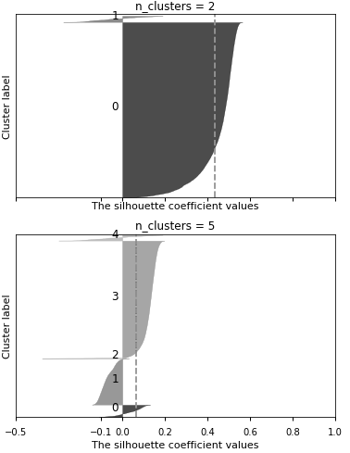
Data Analysis
Label Propagation: Results
Using K-Means we couldn’t display a satisfying clustering of the samples:
Could be because of the curse of dimensionality
Or because our clustering algorithm is too simple or unfitted to that particular task
But we highlighted two ways of improving the scores:
Dimensionality reduction techniques
Balancing training set
In order to evaluate how confident we are of describing an underlying structure: silhouette analysis
Notes:
Limited HFC time => must be confident of clustering
We used silhouette analysis: metric that qualifies the quality of the cluster structure displayed
K-Means most popular: no good results regarding structure could be due to curse of dimensionality or too simple model
Showed that Dimensionality reuction and class balancing are helpful
Time constraint: move to prediction in the hope to have more complex model to explain the underlying structure
-------------------------------------------------------------------------------------------------------------------------------------------------------------------------------------
HFC support team can only dedicate a limited amount of time in order to analyse the output of our clustering therefore we had to make sure that we are confident in our clustering before submitting it to review.
In order to check the performance of such clustering we use what is called a silhouette analysis, it provides a single number metrics evaluating the quality of the displayed structure.
Unfortunately our exploration using the most popular clustering algorithm called K-Means didn’t yield any clustering with a satisfying structure. This could be explained by either the curse of dimensionality or the fact that this particular algorithm isn’t fitted for the given task.
Nevertheless it allowed us to test some techniques that could prove to be useful for further research. We have shown that dimensionality reduction techniques yielded better silhouette average score as well as balanced training datasets and this choices will drive further ressearch.
We could have tried other clustering algorithm but because of the time constraints we decided to move to prediction models as they might be able to unveil more complex structure in the data.

Slide 26
Current State
HFC Architecture
Identified Problem
Data Sources
Dataset Construction
Failing CPE Identification
Health Measurements
Offline CPE Handling
Implementation
Data Analysis
Exploratory Analysis
Data Preprocessing
Label Propagation
Prediction
Cross-Validation
Performance Metrics
Model Exploration
Discussion
Model Output and Behaviour
Improvements
Notes:
Which is why we will now explain the prediction part of the project.

Slide 27
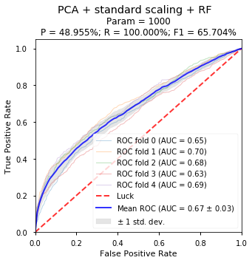
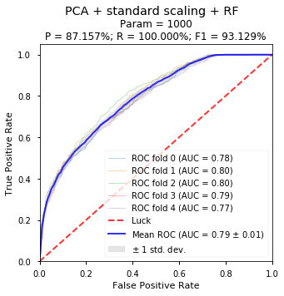
Prediction
Cross validation
Initial assumption: We can use the dataset of vectors where (Day_0, MAC) is a key to build our folds
5 Fold Cross Validation
Wrong assumption: We need non overlapping dates in the training and testing set
[93.74%; 87.05%; 97.01%; 90.22%; 85.10%]
Avg = 90.62%
Std = 4.33%
Notes:
Before we can start looking at the results I would like to spend some time explaining how we evaluate the performance of our model.
- Explain why we do cross validation: obtain unbiased estimate of performance metric
- Here example of 5-fold CV, we shuffle, split in 5 and then for every fold combi train on 4 and test on 1, compute accuracy [CLICK++]
- Gives us mean and variability of the model.
- [CLICK] initial assumption
- [CLICK] time gap influence proved it wrong even with 0 day between test and train just non overlapping.
First we will discuss our cross validation technique: usually in machine learning we work with a limited set of labelled samples that we us in order to train and test our model. The problem is that tuning a model on a restricted dataset can lead to overfitting this particular dataset and not focusing on the true underlying pattern. In order to compute unbiased performance metrics the standard method is to use cross validation.
Let us look at the example of a 5-fold cross validation. Let’s say we want to evaluate the accuracy of our model. We shuffle our dataset, split it in 5 folds. And we train on 4 folds, test on the last one. [CLICK, CLICK…] We compute the accuracy for each training set/testing set combination and it gives us [CLICK] the average accuracy on unseen data and the standard deviation which informs us on the stability of the model.
[CLICK] Initially we thought that we could build these folds on the full dataset. And we started exploring different models based on this. Unfortunately once we were done with exploration we got interested in the influence of the time between training and testing. So we looked at the performance of the model depending on the gap in dates between the training set and testing set and we found out that even with 0 days between the two but with non overlapping dates the performance of the model significantly dropped [CLICK].
If the model is to be used in real life we will obviously be in such case and therefore in order to evaluate the performance of our model we built a cross validation that only considers non overlapping dates between test and training.

Slide 28
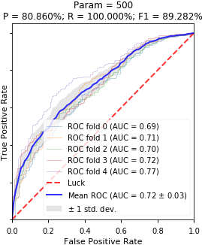
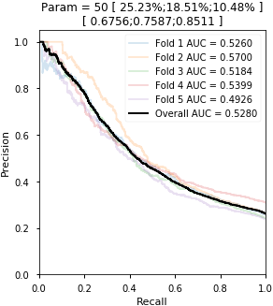
Prediction
Performance Metrics
Imperfect data: focus on top prediction
What do we monitor: we care about how precisely we can detect a sick CPE and how many we can detect
1. Receiver Output Characteristic Curve
2. Receiver Output Characteristic Curve
Precision, Recall and F1 score on top 20% predictions
Focus on curves with steep curve at beginning
Look at Recall for given Precision levels 70,80 and 90%
Focus on strictly decreasing curve and highest AUC
Arbitrary 20%
Doesn’t discriminate well in case of imbalanced classes
Notes:
- We now have a way to obtain unbiased performance metric but we should see what metric we would like to use.
- Give our two underlying goals
[CLICK] started with ROC curves, explain basics of ROC curves and explain that we chose to focus on P,R,F1 for top 20%
[CLICK] then we moved to PR curves, discriminate better and also get max recall for prec.
----------------------------------------------------------------------------------------------------------
pNow that we have a mean to cross validate our performance metrics we need to find which metric we would like to use. We are in the presence of imperfect data and for the sake of this proof of concept we will focus only on top predictions and hope that data improvements will allow to extend the performance over the whole set of predictions. Also what we care about is how well we can predict that a CPE is sick and how many of the sick CPE we can highlight.
[CLICK] In our initial analysis we used ROC curves. The simple idea behind this curve is to order in decreasing order the sick probabilities output by our models. For each such prediction we go up if the CPE is indeed sick otherwise we go to the right. Along with this graphical interpretation we monitor the precision and recall on the top 20% predictions.
[CLICK] But this method had some downsides: first of all, considering the top 20% is an arbitrary choice that doesn’t take into consideration how the testing set is composed. Also it doesn’t discriminate as well the different models when in presence of imbalanced classes
[CLICK] Therefore we moved to precision recall curves. To build such curve we find the different thresholds of sick probabilities that yield different (Precision,Recall) tuples. But also to fit business needs we decided to look at 3 different precision levels from 70 to 90% precision. And for each we looked at the maximum recall that could be reached. This is justified by the fact that recall is the key to business use of the predictive model.

Slide 29
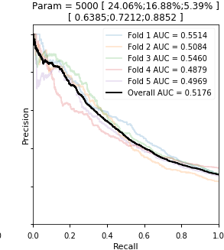
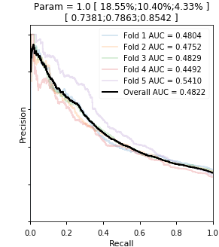
Prediction
Model Exploration
Models explored: Random Forests, Linear and Non-Linear Support vector machines, Gradient Boosting, k-Nearest Neighbors, Logistic Regression and Ridge Regression.
Gradient Boosting
Random Forests
Non Linear SVM
Notes:
Our approach regarding model exploration was to try different models combined with dimensionality reduction techniques or not in order to see what model would perform the best on our task.
- (explain tradeoff tuning - # model explored)
- (describe the PR curve for gradient boosting and why better)
Therefore we moved to fine tuning
Each model has different parameters that need tuning in order to show good performance. There is a tradeoff between how well you can tune a model and the number of models that you can try. We have decided to coarse grain tune each model and to explore 7 different models.
You can see that the gradient boosting method has the highest AUC and recall levels of all models. This confirms on the PR curves that show a more stable model and a higher AUC for high precision levels.
Therefore we have decided to move into fine tuning this model.

Slide 30
Current State
HFC Architecture
Identified Problem
Data Sources
Dataset Construction
Failing CPE Identification
Health Measurements
Offline CPE Handling
Implementation
Data Analysis
Exploratory Analysis
Data Preprocessing
Label Propagation
Prediction
Cross-Validation
Performance Metrics
Model Exploration
Discussion
Model Output and Behaviour
Improvements
Notes:
We should now present and discuss the final model that was obtained.

Slide 31
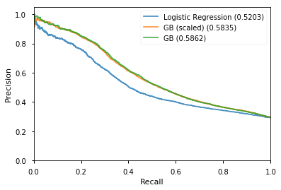
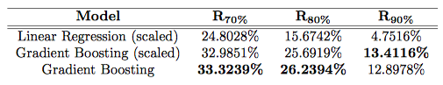
Discussion
Model output and behavior
Model performance are not affected by time gap between the model training and usage (tested up to 12 days)
4 out 5 predictions checked with HFC support expert are true positives.
Notes:
Final model: GB + unscaled + no dim red
- A fourth of sick CPEs can be detected at a usable prediction of 80% which justifies the existence of an underlying structure in the data. Successful POC.
- [CLICK] perf not affected by time
- [CLICK] 4/5 predictions validated by HFC support. Even with questionnable groundtruth we have exposed real issues thanks to our predictions.
----------------------------------------------------------------------------------------------------------
Our final model was gradient boosted trees using unscaled data and without any dimensionality reduction techniques. We can see that the unscalled version is more stable on high (P,R) pairs.
For a usable precision of 80% on our prediction we successfully detect about a fourth of sick CPEs. This justifies the existence of an underlying pattern in the data to push this proof of concept toward a production ready model.
So far, as we have seen previously the model needs to wait 9 days to label CPEs for training because of the FTR Flag therefore we need to make sure that this won’t lower the prediction performance.[CLICK] We tested how the time gap between training and testing would influence the performance and found out that up to 12 days it wouldn’t influence the quality of predictions. This shows that we coul potentially re-train the model on a weekly basis without fear of quality degradation.
[CLICK] Also, we finally could use the knowledge of network experts at UPC. We brought to them 5 predictions to check if indeed they correspond to failures. Out of these 4 CPEs were experiencing problems. The last one showed evidence of data polling issues. This supports the fact that even with a criticizable groundtruth our prediction are meaningful in real life.

Slide 32
Discussion
Improvements: Recommendations
This project was designed to prove that we could leverage the data owned by UPC to improve customer experience.
Decreasing the Accuracy to get more recall?
25%
9,00.-
8,54.-
Proportion of failing CPE that can be detected with a 80% accuracy
Not very efficient as we will then need to have someone from HFC support to check the predictions and this costs the same as dealing directly with the call
Our recommendation
Improve the data to improve the performance
Store the MAC concerned by VIA interaction
Leverage feedback from the customer, ask them if their problem was solved
Use CPE software logs
Notes:
Looking at the tradeoff between precision and recall one could wonder why we shouldn’t decrease precision for more recall.
[CLICK] The main reason is that checking our predictions is almost as costly as servicing the failure using our good old passive method.
[CLICK] This is why our recommendation is to improve the data rather than use the model as it is. This project was designed as a POC to display evidence of an underlying structure in the data correlated with CPE failures. A couple of path that could be followed in order to improve the performance could be:
Improve how VIA data is collected: e.g. by storing the MAC that is being serviced
Leverage feedback from the customer to determine whether we have a FTR or not
Use other sources of data: for example software logs could be such source, it would allow to detect more easily failures but also to handle CPEs with deep sleep mode.

Slide 33
Discussion
Improvements: Using Predictions
Once we have the predictions we need to determine how we can use it. We have compiled a couple of ideas that we would like to throw out there as food for thoughts
We cannot be sure that the CPE is reachable as we diagnose connection problems
The predictions can be available in the early morning (3am). From this we could have two distinct cases:
Problem can be fixed remotely (e.g. Reboot,…)
Design a tool that can detect if the CPE is online
Applies successive automatic steps to solve the problem (e.g. reboot)
The predicting algorithm would:
Increase the Net promoter Score (NPS).
Reduce the load of customer care call centers.
Problem requires physical interaction: Self Care
Send a proactive notification to the customer
Giving the steps he should follow if he is experiencing a problem
Providing him with a reference that can be given to the call center to skip these steps if it didn’t fix the issue: only a few cases require the intervention of THD agent (e.g swap,…)
Notes:
- ++ satisfaction for multiple shareholders: will to move to advanced data predictive models
- we think it is necessary now to define how we wish to use predictions as it will drive further work in terms of requirements.
[CLICK] important note: most important feature is offline over last 24h => must consider that most probably it is offline
[CLICK] (Read through how we could handle predictions)
[CLICK] what this approach would add to UPC
-----------------------------------------------------------------------------------------------------------
The presentation of this project to different stakeholder at UPC (both on the network and customer car business line) has generated a lot of interest and the company is now thinking about deploying such a project and investing into big data capabilities.
Before a project can be launched, we believe that it is necessary toi think about how the firm can leverage such tool. This will allow a clear definition of the requirements for such tool (precision, recall, training time etc…)
We have tried to compile some ideas that could be explored.
[CLICK] First of all it is important to note that during our exploration of the final model we found out that the most important feature was the offline percentage over day 0 being non zero. Hence we can expect a CPE that is predicted sick to be offline.
[CLICK] (display prediction handling protocol)
[CLICK] With such use, the predictive model could allow UPC to raise its NPS due to an increase in customer satisfaction btu it could also reduce its costs by decreasing the load that is put on customer care call centers.

Slide 35
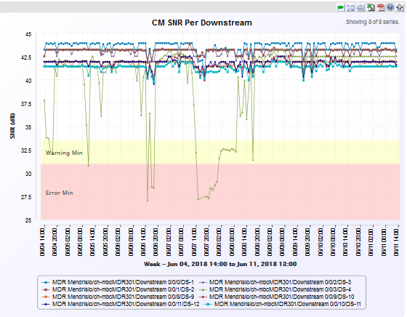
Extra Slides
Prediction example 1/2
We met with Jonas Staempfli to look at some MACs and we have highlighted some particular problems on two MACs that were detected by the algorithm.
Service degradations
Packets are dropped on this particular modem channel
May result in performance issues
Most probably bad cabling
Cable change doable by the customer

Slide 36
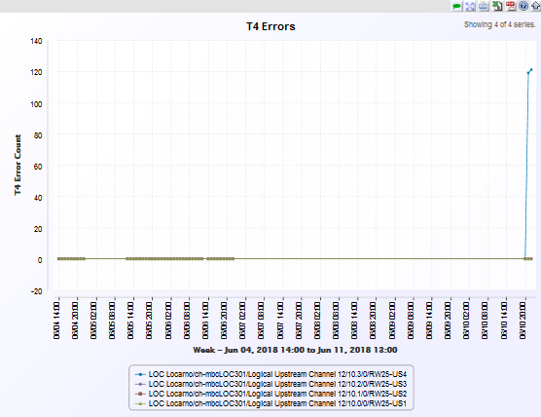
Extra Slides
Prediction example 2/2
Service degradations
Modem HFC interface resets very often
No connection during resets
Modem Hardware issue (swap)

Slide 37
References
[1] Photo by Randall Bruder on Unsplash
[2] Photo by Štefan Štefančík on Unsplash

